Slide 1


Realtime IoT Defence
Presented by : Toyatma Fedee
Ciaran Meade
Eoin Finney

Slide 2
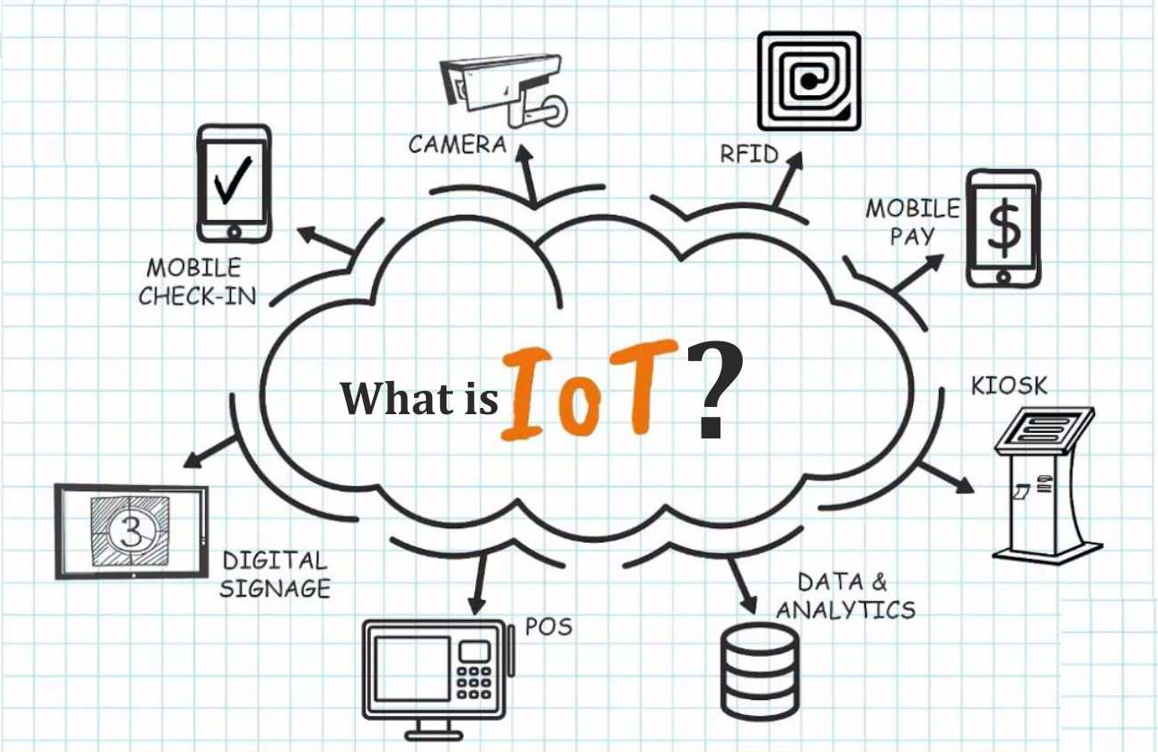
What is Internet of Things ?

Slide 3
The Internet of Things (IoT) is an ever-expanding network of physical devices with an IP address allowing internet connectivity, as well as the communication that takes place between these devices as well as other Internet-connected devices and systems.
Basically, The Internet of Things (IoT) is a network of interconnected physical things that can be accessed over the internet.
It is also denoted by “Internet of Everything”

Slide 4
Components of IoT
Smart Systems and Internet of Things are driven by a mixture of :
Connectivity
Sensors
People & Processes

Slide 5
Why Internet of Things (IoT)?
Industry and daily life are under dynamic control
Improves the ratio of resource use
Bringing human and physical systems together
Configuration options are numerous
Assists with the integration of technologies
Inter-networking on a global scale

Slide 6
IoT Communication Model:
Device to Device
Device to Cloud
Device to Gateway
Device to Back end Data sharing

Slide 7
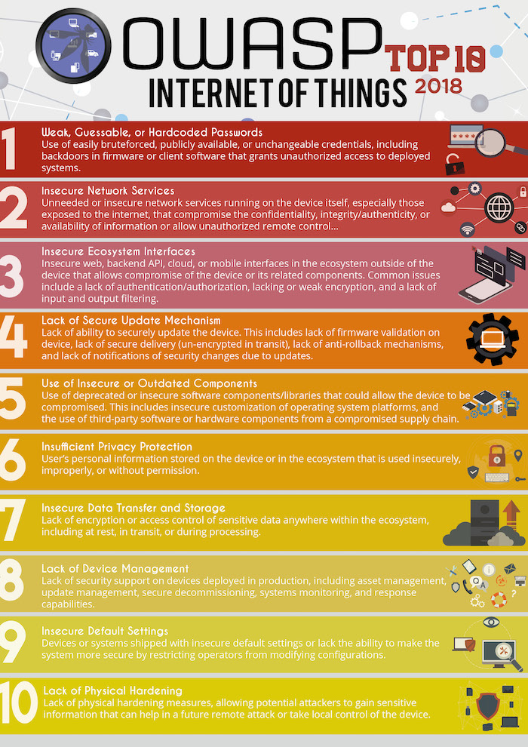

Slide 8
Understanding Attacks on IoT
Lack of security software
Interoperability Issues
Unskilled Manufacturers
Physical Security Risk

Slide 9
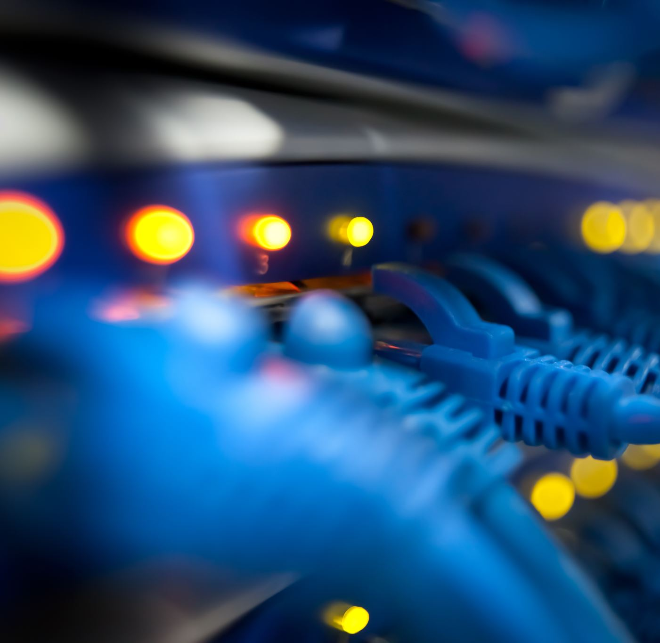
IDS vs IPS

Slide 10
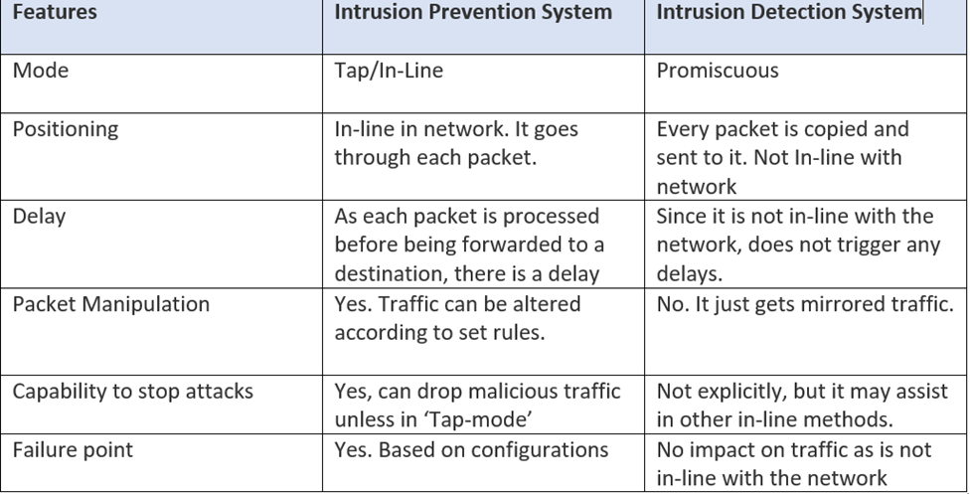

Slide 11
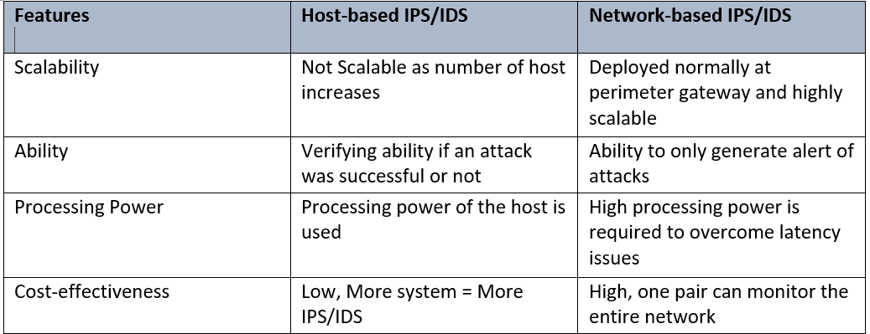

Slide 12
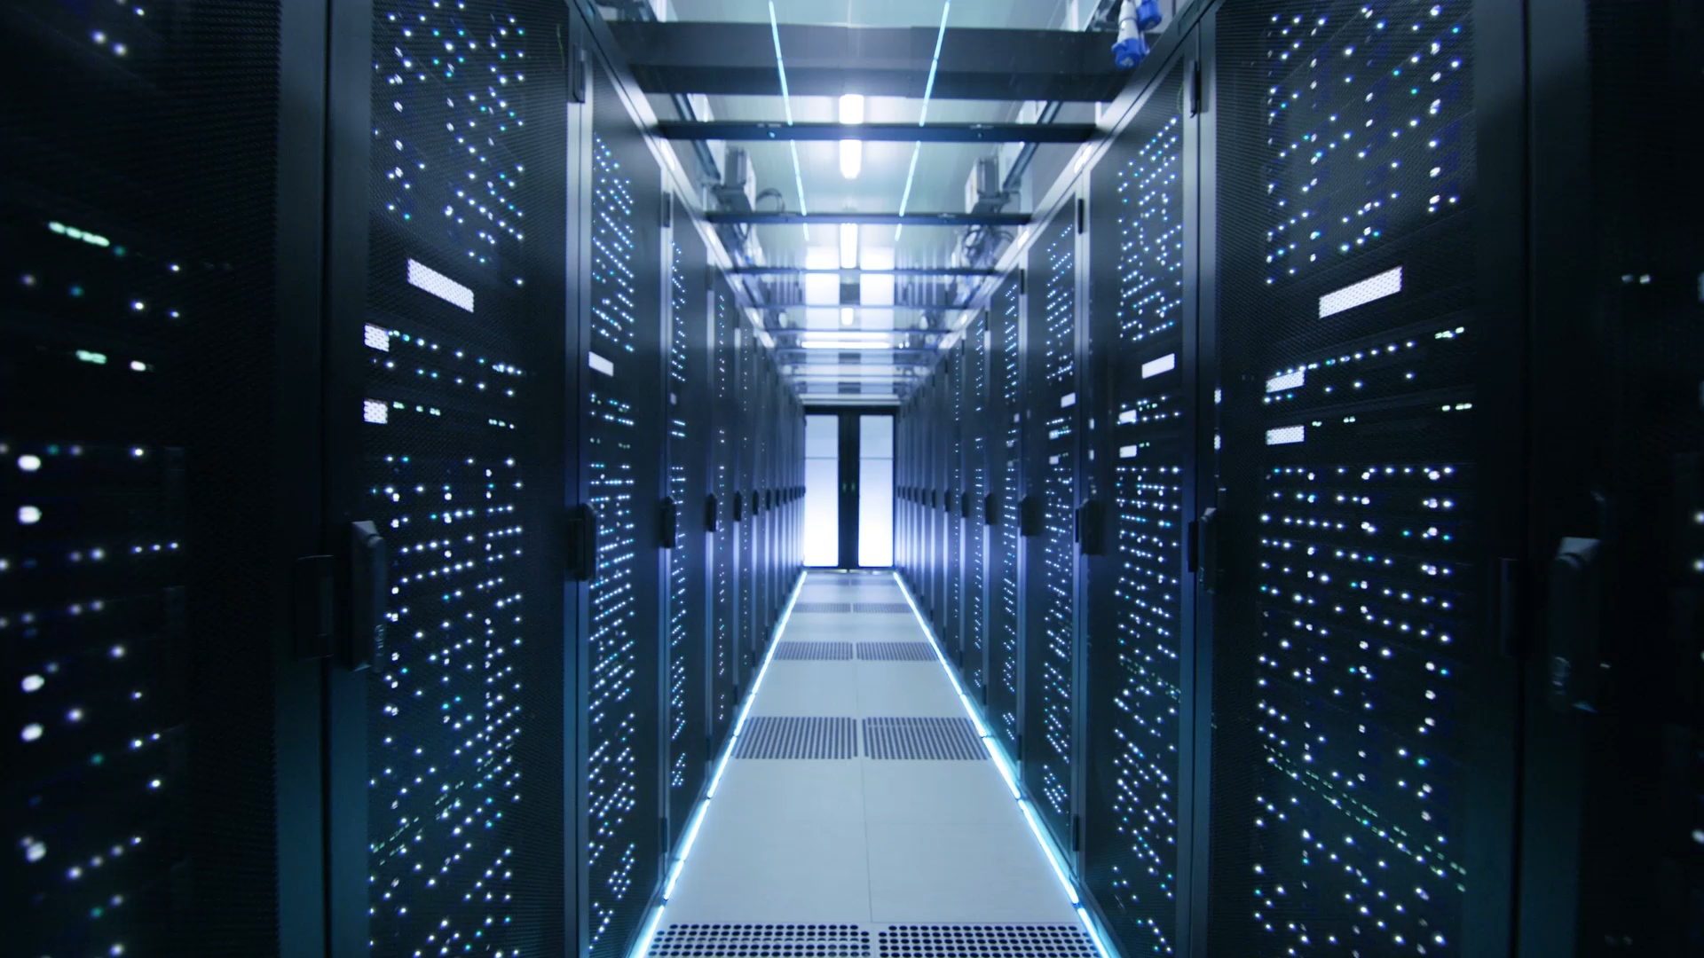
Firewalls

Slide 13
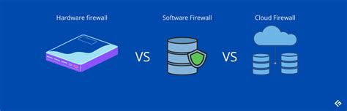

Firewall can be software, hardware, or cloud based

Slide 14
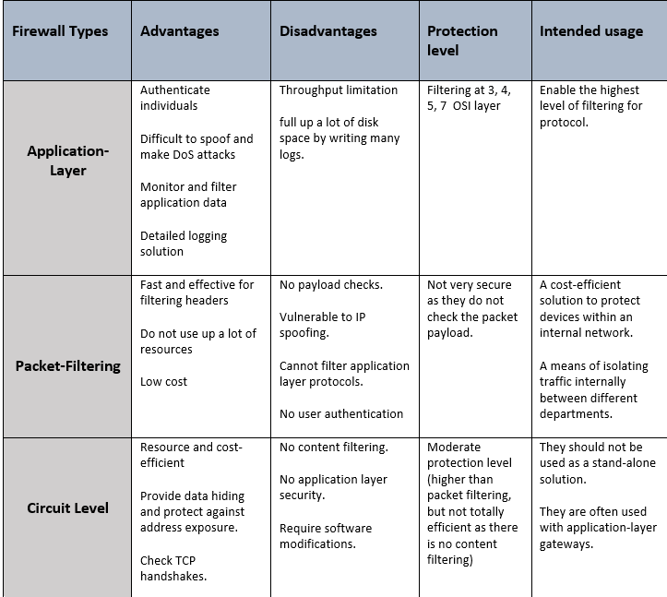

Slide 15
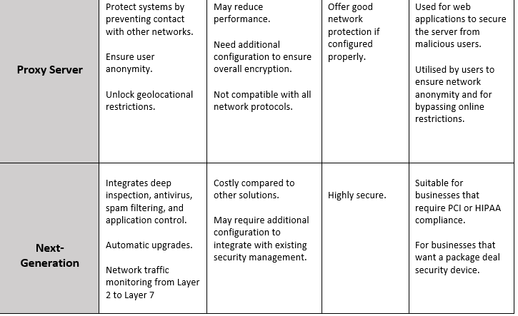

Slide 16
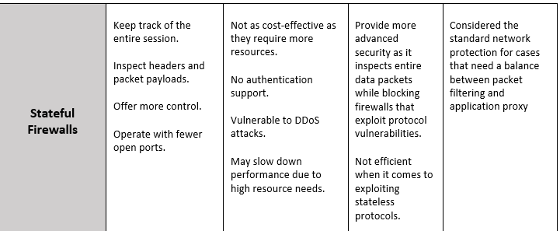

Slide 17


Honeypots

Slide 18
Honeypot are a fantastic resource to log common and uncommon attacks made against a computer, and against an entire network.
We used Tpot Community Edition as our Honeypot framework, due to the scalability and the amount of choice it gave us.
In our project, we had numerous honeypots running, which included IoT specific honeypots.

Slide 19
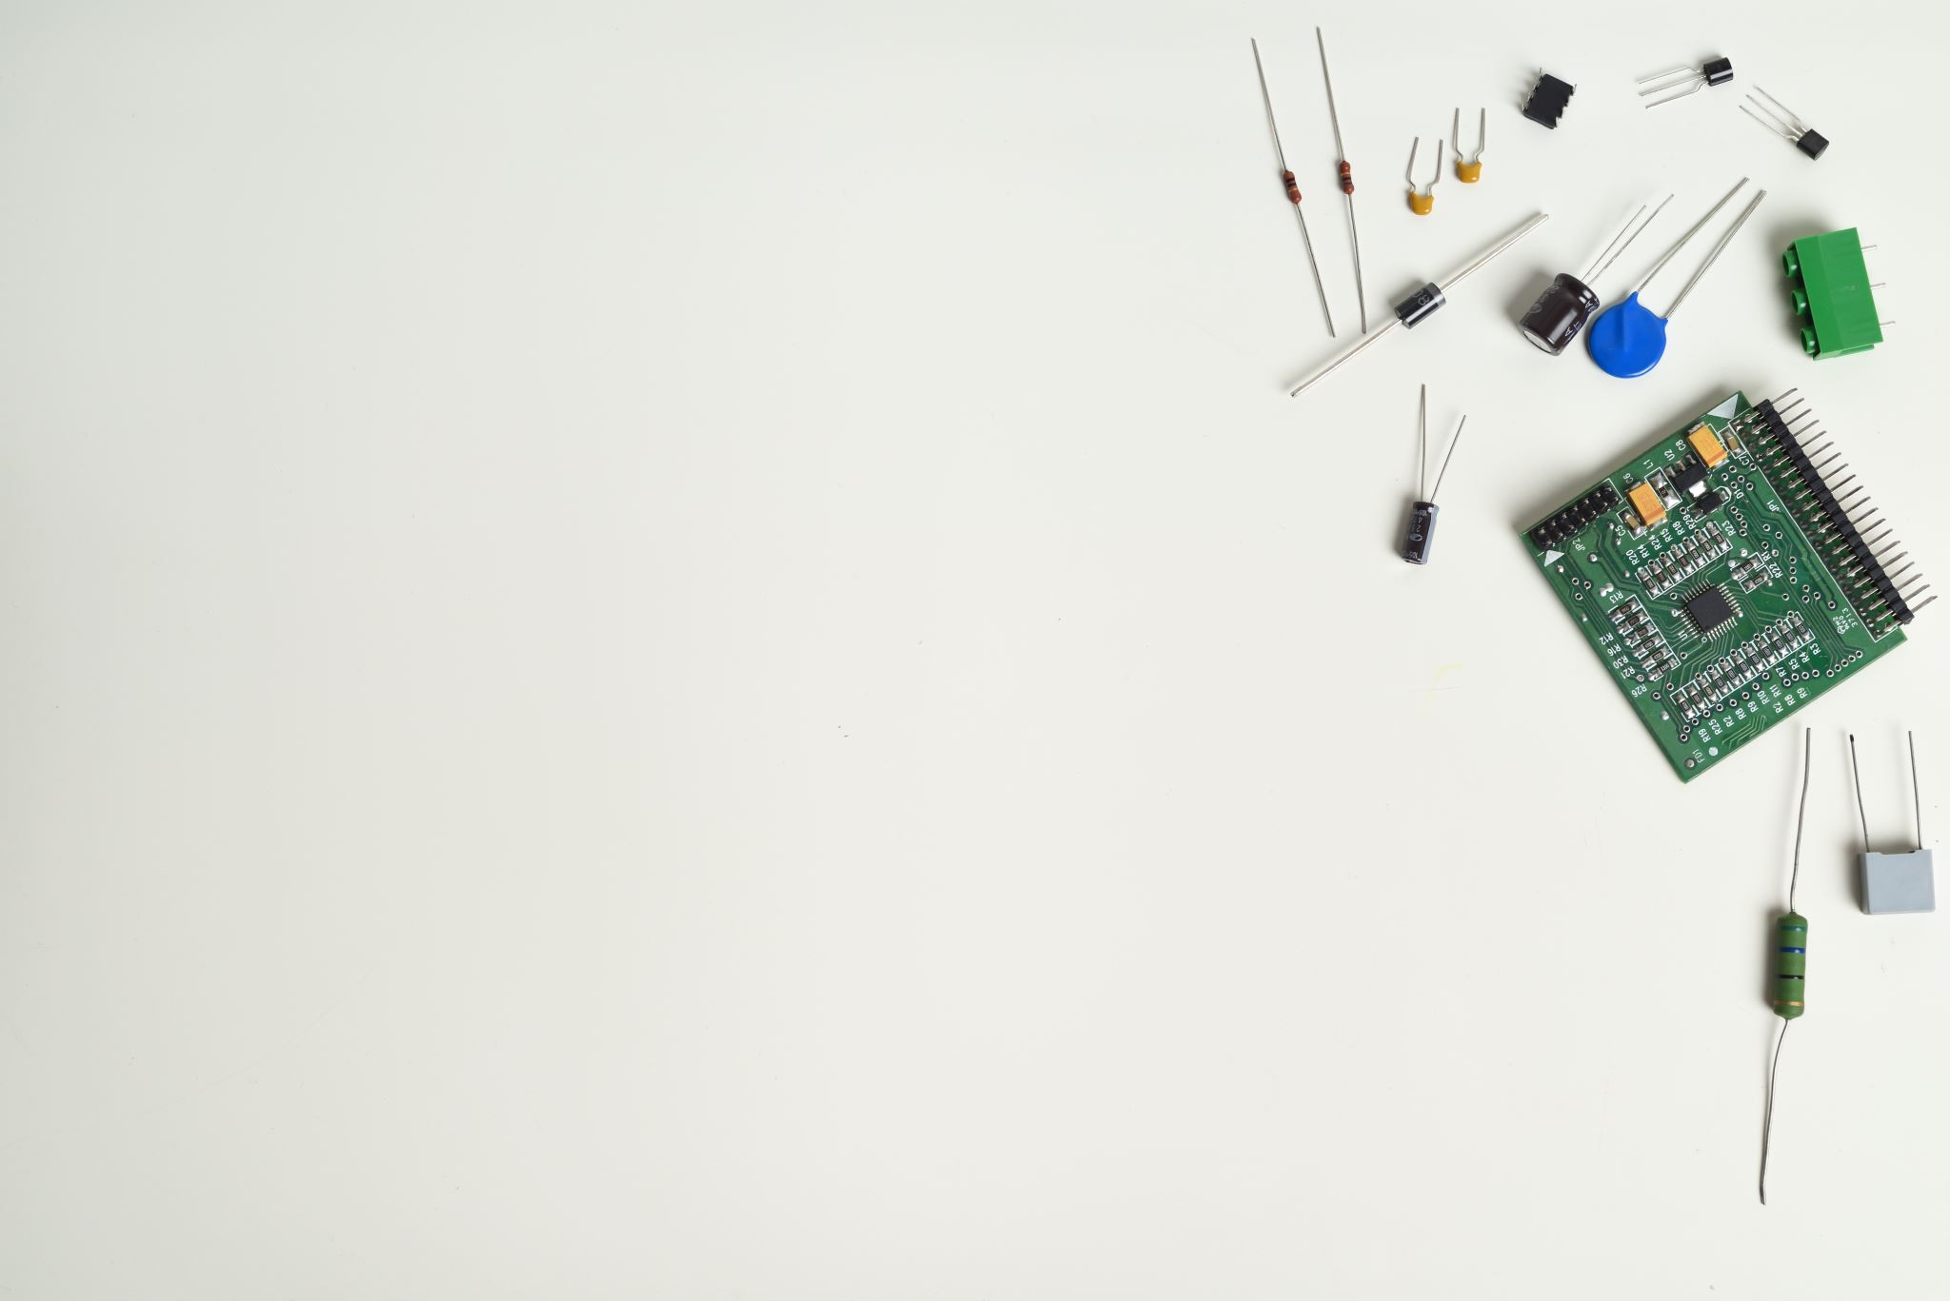
Cronjobs and the Use of Firewalls

Slide 20
Cronjobs were key in how we achieved our goal of real-time defence of our2 network.
Cronjobs are manually-set scheduled tasks that occur whenever the user wants.
We set our scripts to run every 4 and 5 minutes.
Our scripts consisted of the following:
Our first script took in the most recent events that Suricata logged, took the IP addresses out (excluding a few important ones).
The second script then ran that script and sent the IP's taken from that and put them in a file, making sure there were no duplicates.
The third script took all the IP addresses in the file and dropped all of them via iptables (a built-in firewall in all Linux distributions).

Slide 21
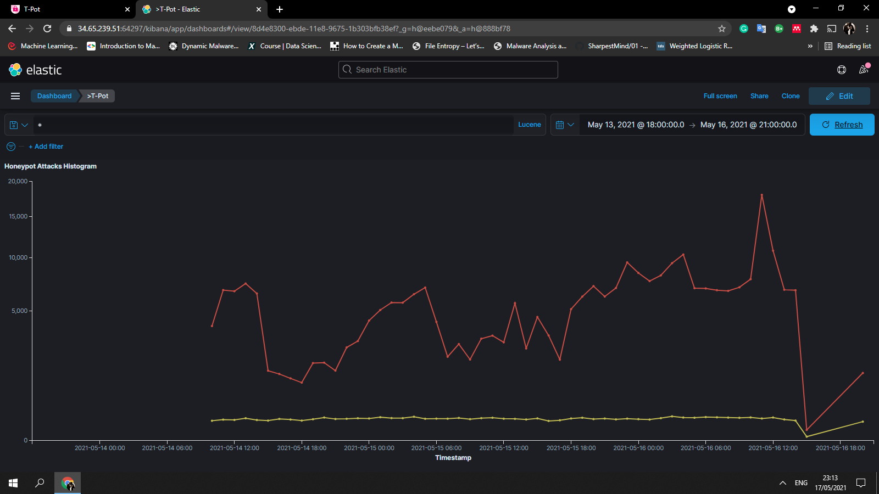

Slide 22
Question Time!

